Slide 1


Lesson 8-2
Turing Machine Encoding
Theory of Computation
王轩
Wang Xuan

Slide 2
Outline
Some languages are not Turing-recognizable
‾A_{TM} is not Turing-recognizable

Slide 3
IDEA：Some languages are not Turing-recognizable
1. The set of all strings Σ* is countable, for any alphabet Σ.
2. The set of all Turing machines is countable.
3. The set of all languages is uncountable.
Thus, some languages are not recognized by any Turing machine.

Slide 4
Proof
1. The set of all strings Σ* is countable, for any alphabet Σ
  Form a list of Σ* by writing all strings of length 0, length 1, length 2, and so on.
  Σ* over the alphabet {0,1}

Slide 5
Proof
2. The set of all Turing machines is countable.
  Each Turing machine M has an encoding into a string <M>. Turing Machine Encoding

Slide 6
Turing Machine Encoding
Q is the set of states {q₁,q₂,q₃,q₄……}
Σ is the input alphabet {a₁,a₂,a₃,a₄……}
Γ is the tape alphabet {b₁,b₂,b₃,b₄……}
δ: Q× Γ -> Q× Γ ×{L,R} is the transition function
q_{start} ∈ Q is the start state
q_{accept} ∈ Q is the accept state
q_{reject} ∈ Q is the reject state

Slide 7
Turing Machine Encoding
Beginning encode 0^{i}10^{j}10^{k}10^{m}10^{n}10^{r}10^{t}
|Q| = i
|Σ| = j
|Γ| = k
q_{start} = q_{m}
q_{accept} = q_{n}
q_{reject}= q_{r}
Blank symbol ⊔ is b_{t}
separator

Slide 8
Turing Machine Encoding
Transition function encode:
δ₁11δ₂11δ₃11……11δ_{n}
For each transition function:
δ(q_{i}, a_{j})=(q_{k}, b_{m}, D_{n}) 0^{i}10^{j}10^{k}10^{m}10^{n}
D_{n}: L/R
  R(D₁):0¹=0
  L(D₂):0²=00
separator

Slide 9
Turing Machine Encoding
Input encode:
a_{i}a_{j} ……a_{n} 0^{i}10^{j}1…0^{n}
Total turing machine encoding:
Beginning encode+111+Transition function encode+111+Input encode
Each Turing machine M has an encoding into a string <M>.
separator

Slide 10
Example
TM M=({q₁,q₂,q₃,q₄}, {a,b},{a,b,⊔}, δ, q₄, q₃, q₂)
δ：
  δ₁(q₄,a)=(q₄,a,R)
  δ₂(q₄,b)=(q₁,b,R)
  δ₃(q₁,b)=(q₂,b,R)
  δ₄(q₂,b)=(q₃,#,L)

Slide 11
Beginning encode
TM M=({q₁,q₂,q₃,q₄},{a,b},{a,b,⊔},δ,q₄,q₃,q₂)
  |Q| = 4
  |Σ| = 2
  |Γ| = 3
  q_{start} = q₄
  q_{accept} = q₃
  q_{reject}= q₂
  Blank symbol ⊔ is b₃
Beginning encode is 0⁴10²10³10⁴10³10²10³

Slide 12
Transition function encode
  δ₁(q₄,a)=(q₄,a,R) 0⁴10¹10⁴10¹10¹
  δ₂(q₄,b)=(q₁,b,R) 0⁴10²10¹10²10¹
  δ₃(q₁,b)=(q₂,b,R) 0¹10²10²10²10¹
  δ₄(q₂,b)=(q₃,#,L) 0²10²10³10³10²
  0⁴10¹10⁴10¹10¹110⁴10²10¹10²10¹110¹10²10²10²1
  0¹ 11 0²10²10³10³10²
separator

Slide 13
Input encode
Input encode: ababa 0¹10²10¹10²10¹

Slide 14
Total turing machine encoding:
Beginning encode+111+Transition function encode+111+Input encode
0⁴10²10⁴10⁴10³10²10³1110⁴10¹10⁴10¹10¹1
10⁴10²10¹10²10²110¹10²10²10²10² 110²10²10³10³10²1110¹10²10¹10²10¹
  Turing machine M has an encoding into a string <M>
separator

Slide 15
Proof
3. The set of all languages is uncountable
  Let B be the set of all infinite binary sequences.
  Let L be the set of all languages over alphabet Σ.
  Suppose L is a correspondence with B.
  Let Σ* = {s₁, s₂, s₃,…}. Each language A∈L has a unique sequence in B. The i^{th} bit of that sequence is a ‘1’ if s_{i}∈A and is a ‘0’ if s_{i}∉A. We call it characteristic sequence x_{A} of A.

Slide 16

Cont.
If A is the language of all strings starting with a 0 over the alphabet {0,1}, its character sequence x_{A} would be
The function f: L->B, where f(A) equals the characteristic sequence of A and is a correspondence. Therefore, as B is uncountable, L is uncountable as well.

Slide 17
The set of all languages is uncountable.
The set of all Turing machines is countable.
Thus, some languages are not recognized by any Turing machine.

Slide 18
Turing-unrecognizable Language
A language is co-Turing-recognizable if it is the complement of a Turing-recognizable language.
Theorem: A language is decidable iff it is Turing-recognizable and co-Turing-recognizable.
In other words, a language is decidable if and only if both it and its complement are Turing-recognizable.

Slide 19
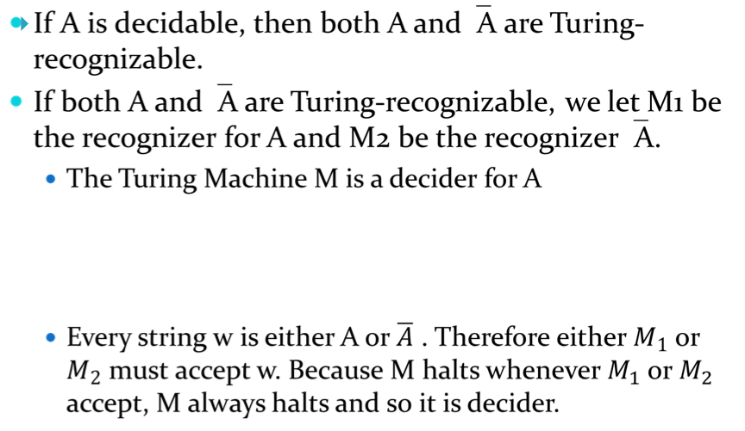

Proof (two directions)

Slide 20
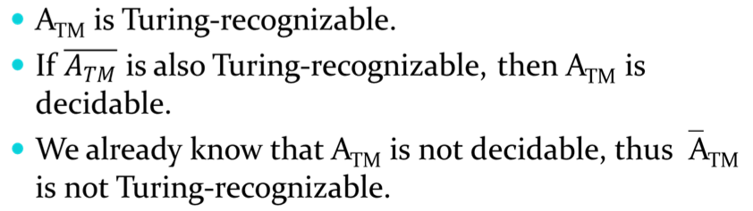
‾A_{TM} is not Turing-recognizable
Proof

Slide 21
Review
The set of all languages is uncountable
Turing-unrecognizable Language
‾A_{TM} is not Turing-recognizable

